Slide 1
Always Encrypted & Dynamic Data Masking - باللغة العربية
Ayman El-Ghazali

Slide 2
Agenda
What is Always Encrypted?
What is Dynamic Data Masking?
Demo

Slide 3
Always Encrypted
Introduced in SQL 2016 – Enterprise Edition Feature
Available with SQL 2016 SP1 Standard Edition
Available SQL Azure SQL Database
Designed to Encrypt Data End-to-End
Encryption/Decryption is handled on the client side
Data is encrypted as it goes through the database engine
Can be scaled out, using multiple client/application servers to do encryption/decryption process
Certificates are not stored in the database engine
Prevents DBAs from gaining access to encrypted data

Slide 4
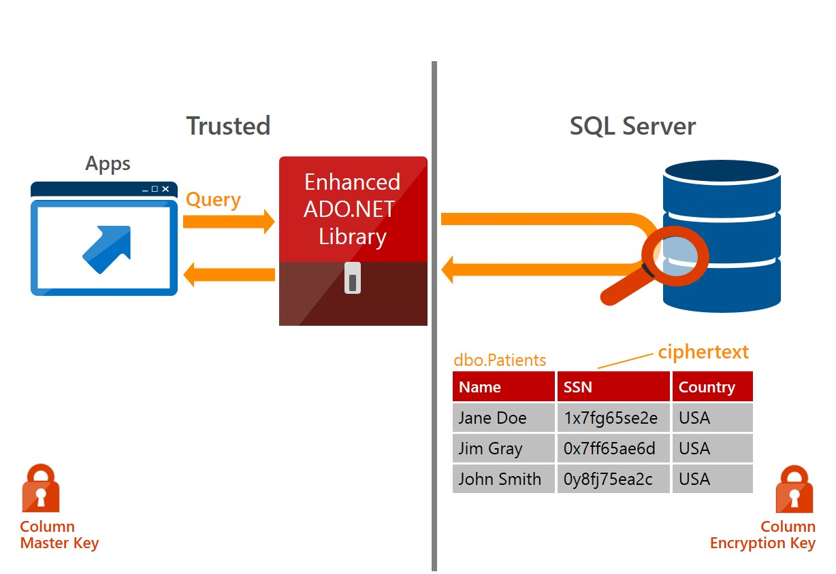
Always Encrypted
http://mscorpmedia.azureedge.net/mscorpmedia/2015/05/Always_Encrypted-graphic.jpg

Slide 5
Dynamic Data Masking
Introduced in SQL 2016 – Standard Edition Feature
Available SQL Azure SQL Database
Designed to Mask specific data upon retrieval
Data is still stored as plain text
Examples:
ayman@email.com → aXXXXXX@XXXX.com
1/1/1980 → XX/XX/XXXX
Not a replacement for proper data security and encryption

Slide 6
Demo
Always Encrypted and Dynamic Data Masking

